Slide 1



Cyber Breach Research
&
Control Recommendations
Shaquilla Chambers
Christopher Phan
Zachary Zerger
Operational Cybersecurity Management
Dr. Branden Williams
Summer 2022

Slide 2
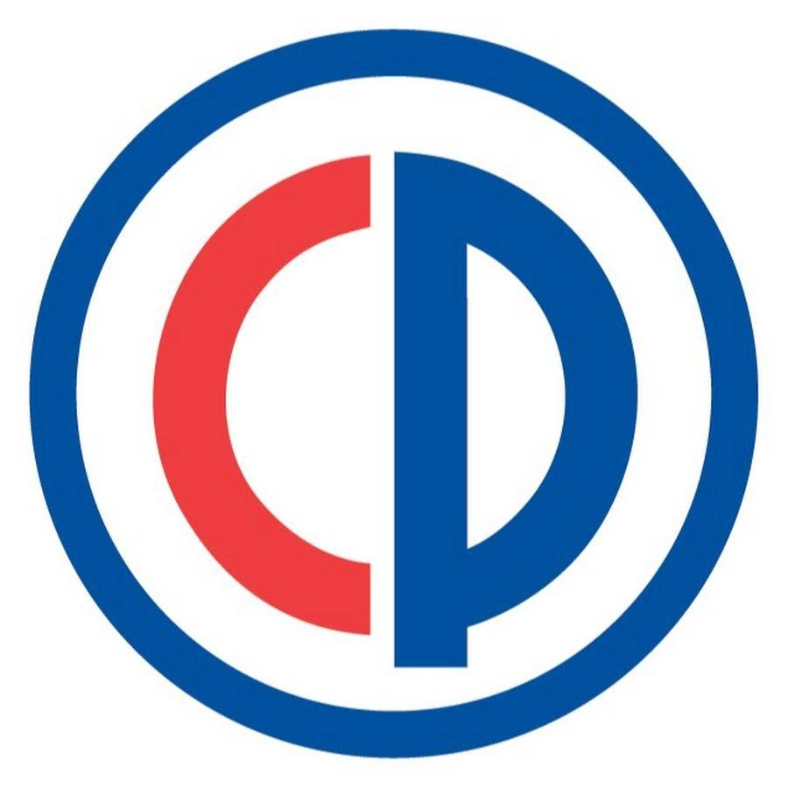
The Colonial Pipeline Ransomware Attack
Colonial Pipeline :
Transports 45% of fuel to east coast
1.3 billion in revenue
5,500 miles of pipeline
Ransomware attack on May 7, 2021:
100 gigabytes of data encrypted
75 bitcoin ransom paid
Darkside group
Six-day pipeline shutdown
Legacy VPN account responsible
Control recommendations:
MFA for all remote access
Vulnerability assessment
Cybersecurity expert Steve Prairie’s recommendations:
Penetration testing
Red team exercises
Notes:
The Colonial Pipeline Ransomware Attack
Colonial Pipeline is the longest pipeline in the US, stretching from Texas to New York. The pipeline is a critical energy infrastructure and vital to the US economy because it supplies 45% of the east coast's gas supply.
On May 7, 2020, the company discovered that a bad actor hacked into their network, encrypted over 100 gigabytes of data, and was demanding a bitcoin ransom. The group was also threatening to publish the data if the company did not pay the ransom.
The company acted quickly and decided to shut down the pipeline immediately and pay the ransom of 75 bitcoins worth $4.4 million at the time. The Darkside hacking group was responsible for the ransomware attack, and they promised a decryption tool so the company could get its data back. The problem was that the decryption was very slow.
The pipeline was down for a total of six days while the company worked to get it back up and running. In the meantime, they worked with the FBI to get most of their bitcoin back. The delay led to gas shortages along the east coast.
The Darkside group was able to get into the network through a legacy VPN, which they had the user's password. The legacy VPN was not utilizing MFA, which the rest of the company had already moved to.
My control recommendations for Colonial Pipeline are first to conduct a vulnerability assessment to find weak points in the network possibly. Then I would make sure all endpoints in the network require MFA.
I met with Cybersecurity director Steve Prairie with Travelers insurance, who pointed out that the company should implement more penetration testing and red team exercises to discover any weak points in their network. The testing may have exposed the legacy VPN.

Slide 3

Okta Data Breach by Lapsus$ Group
Okta:
Identity and Access Management
62% revenue growth Y/Y
$14 billion market capitalization
Cyber breach on January 21, 2020:
25-minute breach
Two customer accounts viewed
Lapsus$ Group
Vendor account compromised
Delay in reporting
Control recommendations:
Vendor risk assessment
Incident response plan
Vendor access controls
Vendor MFA
Cybersecurity expert Steve Prairie’s recommendations:
Log application access
Notes:
The public company Okta is a fast-growing identity and access management company that provides security solutions to many large corporations. Many corporations use Okta, so they don't get their data stolen or their network hacked, so it was a surprise to many people when they revealed they had been hacked on March 22, 2022.
On January 20, 2022, Okta security noticed someone added an authentication factor to one of its vendor's devices. They quickly blocked the device's access to Okta's network and had the third-party vendor do an investigation into the incident.
Okta's vendor used another vendor to investigate the possible breach, and by the time it made it back to Okta, it was March, and the Lapsus$ group had already exposed screenshots of their breach on Telegram. Even in the first communication, Okta indicated they were never breached. They finally admitted they were breached for 25 minutes and viewed two vendors' information.
During this period of uncertainty, Okta's stock price plummeted. Lapsus$ used a pass the hash tool named Mimikatz to break the steal the vendor's credentials.
Okta should complete a vendor risk assessment to help assess its vendor vulnerabilities. The vendor should be held to the same MFA policy as the company. Okta should also implement access controls to limit each vendor user's access to customer information. The company should also implement an incident communication plan to add consistency to the public messaging.
One thing that my cybersecurity advisor Steve Prairie mentioned was that they took a long time to figure out what was accessed. With logs, this would not have taken as long.

Slide 4
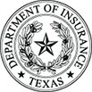
Texas Department of Insurance Data Leak
Texas Department of Insurance:
Regulates Texas insurance providers
Collects and stores provider data
1,217 employees
Unintended data disclosure from March 2019 until January 2022:
1.8 million individual records
PII and PHI disclosed
Coding error
Omitted audit details
Control recommendations:
Network segmentation(DMZ)
Pen testing
Access controls
Data encryption
Cybersecurity expert Steve Prairie’s recommendations:
Web application firewall
Notes:
From March 2019 to January 2022, the Texas Department of Insurance (TDI) unintentionally disclosed 1.8 million records that included individuals' PII and PHI through a public internet site. TDI revealed this information in March 2022 after an audit. They indicated it was due to a coding error and fixed the problem immediately. TDI failed to disclose any more details about the coding error.
After reviewing the incident, it is apparent that there should have been controls in place to prevent this from happening. The data was Workers' Compensation data provided by insurance companies. The web application server used by the insurance companies should have been segmented off from the public internet web server and placed in a DMZ. They could use an extranet setup with a VPN connection to accomplish more security. TDI should have done more penetration testing to find the vulnerability sooner. Since the data is sensitive, they should store it in an encrypted format. There also should be strict access controls in place to allow for limited access to sensitive data.
Director Steve Prairie indicated there might be a more straightforward solution than creating an extranet with a VPN connection to the insurance companies. A Web Application Firewall (WAF) could be put in place to manage incoming access to the web application and would be a cheaper option.

Slide 5

Elliott Greenleaf Law Firm Data Theft
Elliott Greenleaf Law Firm:
55 attorneys
Multiple locations
Data theft from November to December 2021:
Entire office resigns
Client and case data stolen
288 pounds of documents shredded
Google Drive and Apple iCloud
Control recommendations:
Data extraction monitoring
Blacklist personal email and cloud storage access
Access controls
Cybersecurity expert Steve Prairie’s recommendations:
Automate employee monitoring
Use technological solutions to alert the abnormal activity
Notes:
In the last few months of 2021, a group of disgruntled attorneys from the law firm appear to have decided to switch firms. Before they changed employers, they downloaded a lot of the firm's case data and client information so they could use it at their new firm. They used Google Drive and Apple iCloud storage to extract the company data. They then deleted many of their company emails and shredded 288 pounds of paperwork, and charged the firm for it.
To avoid this in the future, the company should blacklist the use of personal email or extraction software applications on its workstations. They should also limit the access the attorneys have so only their client's data is accessible. The firm likely knew they had some disgruntled staff at the time. They could have set up some monitoring to watch for data extraction.
When discussing the case with Steve Prairie, he brought up that monitoring should be done through technological means and not someone physically monitoring the behavior. Possibly some logging software could have alerted the large amounts of data being extracted in this case.

Slide 6

Target’s $18.5 Million Multi-State Settlement over Data Breach
Target’s third-party vendor falls victim to phishing attack that led Target’s customers to become victims of sensitive Personal Identifiable Information (PII).
My control recommendation:
Risk Management
PCI DSS Controls
Information Protection Processes and Procedures
Awareness and Training
Least of Privileges
The Director of Cyber Risk at Brink’s Inc, Angel Mosley's recommendations:
Implement a comprehensive risk assessment process that use a framework like NIST 800-53
Least of Privileges with Third-Party Vendors
Network Segmentation
PCI-DSS
Notes:
Target had one of the largest breaches on November 29th 2013 till date. The third-party vendor Fazio Mechanical which has access to Targets data system, fell victim to a "spear phishing” attack. The
intruder stole the vendor’s credentials which were used to access their system. The third-party vendor acknowledges using a free anti-malware program which did not offer real-time protection against threats. Approximately, 70 million to 100 million personal information was stolen such as SSN, credit, debit and telephone number.
Based on the research I’ve conducted the recommendation I suggest Target is to perform risk assessment, external & internal vulnerability scanning, implement PCI DSS controls, least of privileges, and security awareness training for in house and third-party vendors.
Director of Cyber Risk, Angel Mosley recommends Implement a comprehensive risk assessment process that use a framework like NIST 800-53, Least of Privileges with Third-Party Vendors and network segmentation.

Slide 7
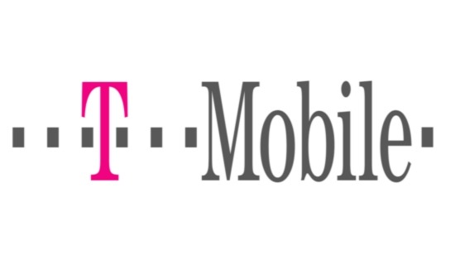
T-Mobile Fourth Breach in Three Years
T-mobile lack of network security controls allows hackers to breach their system once again. In this incident T-mobile had unprotected router exposed on the Internet.
My control recommendation:
Risk Assessment, Supply Chain Risk Management
Continuous Monitoring & Detection
Response & Recovery Plan
Communication (Lesson Learned)
The Director of Cyber Risk at Brink’s Inc, Angel Mosley's recommendations:
Risk Management Program
External and Internal network vulnerabilities scan
Implement at a EDR like Carbon Black and Data Loss Prevention tool like McAfee DLP
Notes:
T-Mobile severely need to implement better risk management practices and a framework like NIST 800-53. The numerous breaches within the three years displays that T-mobile lack Lesson Learned and does not continuous scan their networks for gaps and vulnerabilities.
I think T-mobile did a great decision with partnering with KPMG to implement the risk management program.
My Director of Cyber Risk, Angel Mosley suggested that T-mobile perform a risk assessment and implement a risk management program. As well they should perform an external and internal vulnerabilities on networks and an endpoint detection response like Carbon Black, and a Data Loss Prevention software like McAfee.

Slide 8

700 million LinkedIn Records for Sale
Data scraping vs Data Breach
Data Classification
Difference between previous breach in April 2021
My recommendations to mitigate risk:
Risk Management Strategy
Asset Classification
Protection Technology
The Director of Cyber Risk at Brink’s Inc, Angel Mosley's recommendations:
Monitoring new and existing accounts with a high level of unusual activity
Detecting abnormal views of content
Deploy a security monitoring tool
Deploy tool to block web scraping
Implement real-time notifications
Notes:
During the research of LinkedIn’s “incident” I discovered the difference between data breaches vs data scraping. The importance of data classification (i.e sensitive, classified, restricted) and the context that would classify a data breach. Data scraping is a technique in which a computer program extracts data from the output generated from another program.
LinkedIn’s current incident still has teachable information of data scraping and how to implement controls to mitigate data scraping. My recommendations implement api vulnerabilities scanning at least quarterly and asset classification.
During the discussion of this particular incident, one of Angel Mosley suggestion, that LinkedIn should perform API security test to check for vulnerabilities and security process gaps.

Slide 9
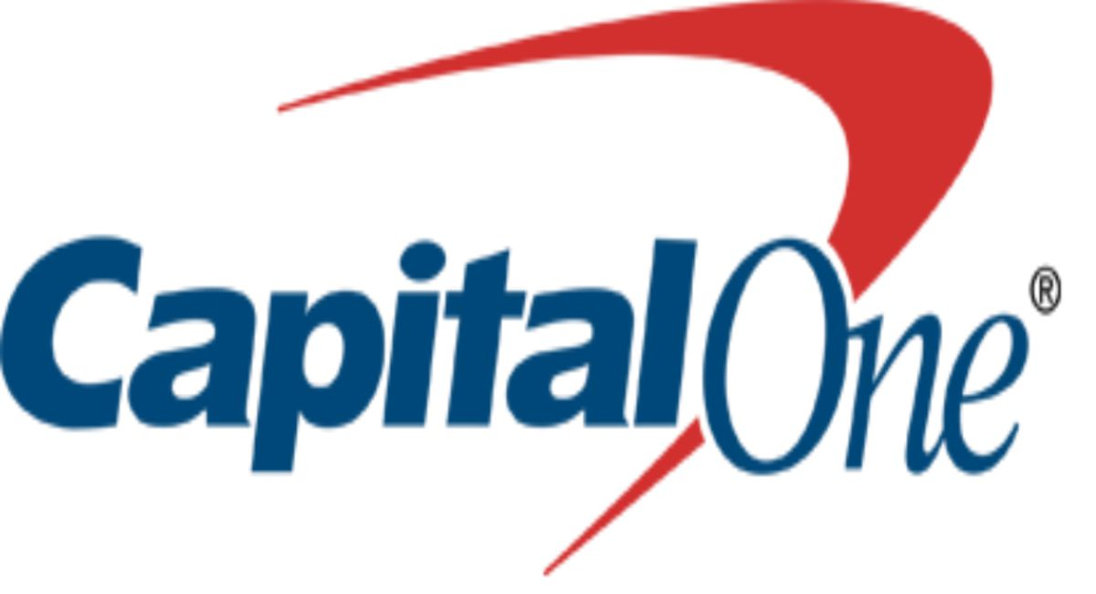
Capital One to Pay $190 Million Class-Action Lawsuit and $80 Million Regulatory Fine After Data Breach
Former System Engineer discovered the public IP address of an AWS EC2 instance which allowed her decrypted and exfiltrated data from the account.
My control recommendation:
Cloud Security
Identity Management
Authentication and Access Control
Implement a cloud-based WAF
Risk Assessment
The Director of Cyber Risk at Brink’s Inc, Angel Mosley's recommendations:
Implement a comprehensive risk assessment process that uses a framework like NIST 800-53 or ISO 31000
Perform manual review of IAM policies and roles
Perform penetration testing to identify any potential vulnerabilities.
Deploy WAF that protection
Notes:
The Capital One data breach was one of the most controversial breach, which landed Capital One to pay a $80 million fine. Capital One’s customer data was stolen by a former AWS system engineer that was able to develop a scanning tool where she identified gaps in Capital One’s rented cloud storage. Paige Thompson was convicted of several federal crimes including fraud.
My control recommendation to mitigate risk execute automated compliance scans to detect any configuration changes of cloud resources. Perform penetration testing to identify any potential vulnerabilities. Perform periodic review of deployed IAM roles and policies with automated checking tools to detect any deviations from the specified baseline. Implement a tool to monitor cloud logs to detect any suspicious behavior.

Slide 10

Baylor Scott & White Medical Center Frisco
Baylor Scott & White Medical Center in Frisco
Short-term acute care facility receives 5,000 patients annually
Revenue of $10.1 billion in 2019
Has 49,000 employees for the entire organization
Control Recommendations:
Routine Risk Threat Assessments
Separation of demographic and financial information
Secure inventory of sensitive information, and limit privileges of third-parties
The Data Breach on September 22, 2018:
Occurred through third-party credit card processing system, AccuDoc Solutions
47,000 patients’ PII was exposed for 7 days
Happened through a compromised network server from software issues with a third-party of AccuDoc.
Cybersecurity Expert. Racquel Rodriguez:
Concurs that least privilege principles needed to be enforced for this case
Have third-parties security policies checked to align with Baylor Scott & White’s policies
Notes:
Baylor Scott & White Medical Center in Frisco is a short-term acute care facility, usually receiving 5,000 patients annually. On September 22, 2018, they were breached through a third-party credit card processing system, AccuDoc Solutions. AccuDoc is a company that operates based on payment and billing services for healthcare providers, and they were the ones to alert Baylor Scott & White about the breach. Based on their findings, 47,000 patients’ PII were exposed, including financial and demographic information. Forensics found that no data was exfiltrated, only viewed. The hack occurred through a compromised network server in AccuDoc, as a third-party vendor was installing new software, allowing a security vulnerability due to implementation conflicts.
The recommendations I believe would best prevent an incident like this for Baylor Scott & White would be inventory management of sensitive information, routine vendor risk assessments, which could identify and evaluate potentials risk that are possible through vendors and third-parties. As well, Baylor Scott & White should have consulted PCI DSS and HIPAA’s guidelines for security. Also, least privilege principles should have been implemented and separation of demographic and financial information, so less information would have been compromised in this breach.
I also discussed with a cybersecurity expert I know, Racquel Rodriguez who has been a security engineer, working at Atmos Energy for 3 years. She actually graduated from the MS Cybersecurity program here at the University of Dallas. She concurs that Baylor Scott & White failed to introduce the least privileged principles for AccuDoc as well as AccuDoc’s software vendor. Also Baylor Scott & White should have conducted checks into AccuDoc’s security policies, ensuring that their security procedures align with Baylor too.

Slide 11

Equifax
Equifax:
One of the three largest credit bureaus
Has an annual revenue of 3.396 billion as of 2018 after the breach
Houses 800 million people’s credit history, and 88 million businesses’ too
Control Recommendations:
Checking and updating vital systems, as well as recertifying security controls as soon as possible
SIEM management
Segmentation of the network and servers
The Data Breach on March 10, 2017:
Unpatched Apache Struts application allowed for access within Equifax’s network
Expired public-key certificate for network sniffer
Breached 147 million people’s sensitive information
Cybersecurity Expert, Racquel Rodriguez:
Applying a CASB system to Equifax
Reputation management and quick response to breaches
Tuning alarms to alert personnel about any exfiltration and breaches in the network
Notes:
Equifax had one of the largest notorious breaches in recent times, being one of the three largest credit reporting agencies and bureaus in the world. The data breach occurred on March 10, 2017, through an unpatched open source framework called Apache Struts. The hackers were capable of taking advantage of an HTTP request vulnerability, allowing them to execute codes remotely and travel through the internal network. Exfiltration began on May 13, 2017, when the hackers began to move from the consumer complaint web portal and into the Equifax servers, which were not segmented whatsoever. This mass exodus of 147 million people’s credit history data was not noticed until July 29, 2017, when Equifax had noticed a 10-month expired certificate for a network sniffer.
The recommendations for this breach are simple and this entire incident could have been prevented if the correct measures were taken. These recommendations include patching and updating all services within the network, and monitoring traffic within the internal network. Segmentation of the network servers, as there was a limited amount of information that could have been accessed if done so. Least privilege principles as well.
Racquel Rodriguez advised that Equifax could have implemented a CASB system, or a cloud access security broker, to ensure that all proper security measures are taken and enforced. If this was implemented, the unpatched Apache Struts would have been seen and updated, the public-key certificate would have been renewed before it was forgotten for ten months, internal traffic visibility would have been activated, and this data breach would have never occurred. She mentions that Equifax failed to silo the network in a way to protect consumers and the company, and that this incident alone provides insight into how there should be changes to vendor solution integration and data breach notification laws.

Slide 12

Yale University
Yale University:
Ivy league school with 12,000 students attending
Yearly revenue of $4 billion in 2019
Has 8,480 faculty and staff members currently
Control Recommendations:
Could have been prevented with tighter controls on data management
Integrity mechanisms are in place to verify the data is correct before sending letters
The Unintended Disclosure Breach September 2018:
Collating errors, leading to Yale sending letters to the wrong addresses
Affected 1,102 individuals’ PHI
Cybersecurity Expert. Racquel Rodriguez:
Database management is overseen
Use of automation to avoid incidents of collating errors
Greater control of integrity for the University to check on sensitive information before being sent
Notes:
Yale University is one of the prestigious Ivy League private universities, though in September 2018, had an unintended disclosure. They had a collating error where they had sent physical letters to the wrong mailing addresses pertaining to 1,102 individuals’ PHI. This error was due to a faulty set of rules that made the database mismatch the information on students, and Yale had not checked the integrity of student data before automatically sending it out.
What I recommend Yale do was to conduct data verification checks, such as integrity mechanisms in place to verify that the information was correct and authenticated. Especially in cases like this, where mass data was changed and mismatched, there should have been notifications to the university and to students as well that their data in the database was incorrect and needed to be authenticated.
Engineer Rodriguez says that collating errors are the results of poor database management, and poor database management is indicative of poor security. This can be seen with the Yale University data breach hack that had occurred a month before. Automated systems should have been in place to check that sensitive data was actually correct for the students, and as well as staff should have checked this too before the letters were sent.

Slide 13

South Georgia Medical Center
South Georgia Medical Center:
Not-for-profit medical center receiving 16,000 patients a year
Has annual revenue of $1.3 billion in 2021
2,900 employees in the Valdosta location
Control Recommendations:
Having exit procedures for employees who quit
Management of least privilege principles in the workplace
Zero-trust policies
The Insider Data Breach on November 12, 2021:
Employee voluntarily left employment
Stole 41,692 patients’ PHI on USB drives
USB drive has been recovered by authorities, though none of the information has surfaced in any forums
Cybersecurity Expert, Racquel Rodriguez:
Implementation of policies of display-only access or blocking large exports, such as usage of USB drives
Specification of zero-trust policies in being applied to system-wide positions
Enforcement of least privilege
Notes:
Lastly, South Georgia Medical Center is a not-for-profit medical center. This insider threat data breach pertains to the Valdosta branch of the South Georgia Medical Center. On November 12, 2021, an ex-employee had exfiltrated 41,692 patients’ PHI through a USB drive from the hospital’s database. The employee voluntarily left employment on November 11, 2021, with no clear sign of why not had any motive against the hospital.
What I recommend for South Georgia Medical Center is to update their privileges of the system immediately to avoid incidents of insider threats such as this. Termination procedures needed to be taken such as escorting the employee out, clearing all accounts on databases and file servers, changing passwords, and such. SGMC may look into a defense-in-depth approach with the seven layers: (1) physical barriers, (2) physical restriction of access to systems, (3) IDS/IPS, (4) Firewall, (5) Software Firewall, (6) Anti-malware, and (7) Encryption. Also, the hospital should look into zero-trust policies, where users will have to continuously validate and authorize themselves into the system.
Racquel Rodriguez mentions that the hospital needs to implement systems of least privilege principles, as right when the employee left employment, all privileges of an employee be immediately revoked and stripped. She says that the hospital should, based on the software and database they have, implement display-only access or block large exports rather than just alerts for it. Even though the hospital states they had segmented the network, this segmentation should apply further to job title and function. She notes that zero-trust policies are much easier to apply to principle than in reality, and revise it to apply to system-wide positions that maintain the organization, as a fast-paced environment where patient’s health is dependent on information cannot enforce zero-trust policies.

Slide 14
Conclusion
The 12 breach cases we have researched have exemplified multiple important factors in creating a secure work environment and network. These companies should have followed the cybersecurity frameworks that have been laid out for them to minimize breach risks, followed the correct procedures of access controls to vital systems, classified their data to be akin to their company makeup, and had a proactive approach to their security rather than a reactive. Our findings have shown that these data breaches could have both been prevented and minimized with our recommendations.
Notes:
The 12 breach cases we have researched have exemplified multiple important factors in creating a secure work environment and network. These companies should have followed the cybersecurity frameworks that have been laid out for them to minimize breach risks, following the correct procedures of access controls to vital systems, classified their data to be akin to their company makeup, and had a proactive approach to their security rather than a reactive. Our findings have shown that these data breaches could have both been prevented and minimized with our recommendations.

Slide 15
